Slide 1
Build a Strong MERN Foundation
Notes:
Trainer Notes:
This slide is self-explanatory, trainer notes not required.

Slide 2
Online Banking Web Application

Slide 3
Planning Project with Agile and Git

Slide 4
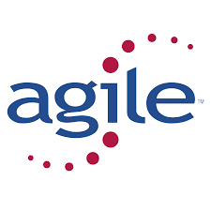
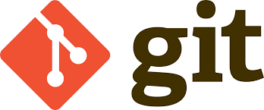

Before we begin, let’s recall what we have covered till now:​

Slide 5
Agile
It is an iterative approach used to manage the development of a software project.
Git
It is a distributed version control system used to handle software projects.
GitHub
It is a web-based platform for version control and collaboration, allowing users to store, manage, and track changes to their code projects.

Slide 6
A Day in the Life of a MERN Stack Developer
As a MERN stack web developers, our key role is to develop full-stack web applications using MongoDB, Express.js, React.js, and Node.js.
As developers, our given task is to develop an online banking application using React.js and Node.js with Express.js as the web framework.
In order to persist the data, the NoSQL database, MongoDB will be used.

Slide 7
A Day in the Life of a MERN Stack Developer
To begin with our project, we need to plan it properly. We will employ the Agile methodology.
First, we will create user stories for the epics, a web admin dashboard for bank authorities, and a web app for the end user.
We will thereafter see how to use Trello and plan the project with our stories. Finally, we will create the project structure and sync the code to GitHub.

Slide 8

Implement the Agile methodologies, such as Scrum or Kanban, in the planning and execution of web application projects
Design a comprehensive Agile strategy for a web application project
Develop a Git workflow strategy for a team-based web application project
Assess the use of Git in managing branches and merging code

Slide 9
Task 1: Plan the Project Using Agile Methodologies

Slide 10
Create a Kanban Board
Create admin user stories as the requirements of the project:
Admin can do the signup for the dashboard with his/her credential.
Admin can view all customer details.
Admin can approve new customers to create the account.
Admin can lock the account.
Admin can search customer details based on email ID, account number, or phone number.
Admin can provide special interest for special customer.

Slide 11
Create a Kanban Board
Create customer user stories as the requirements of the project:
Customer can sign up for the account
Customer can sign into the account.
Customer can request admin to activate or deactivate the account.
Customer can do the signup for the net banking.
Customer can view their account details.
Customer can transfer the amount
Customer can withdraw the amount
Customer can deposit the amount

Slide 12
Task 2: Create Project and Sync Code to GitHub

Slide 13
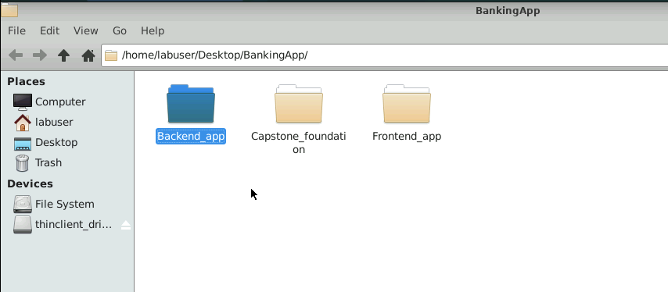
Create the Project Structure
Create a folder named BankingApp and three sub-folders named Capstone_foundation, Frontend_app, and Backend_app
Notes:
Trainer Notes:
The folder names for the project can be different.

Slide 14
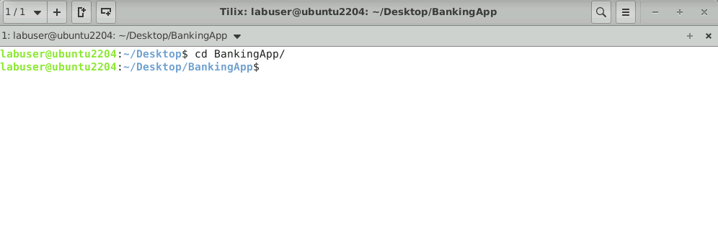
Git Steps to Create Local Repository
Open the terminal and navigate inside the project directory

Slide 15
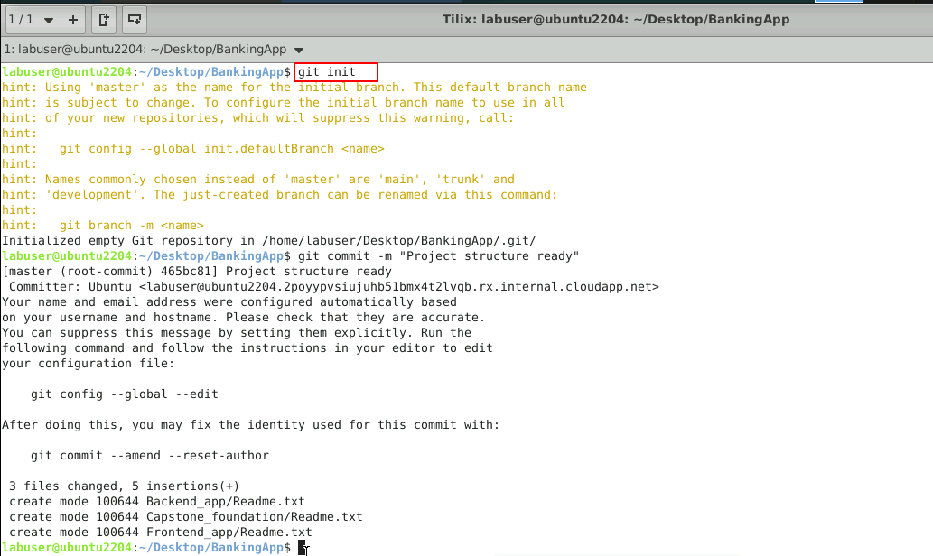
Git Steps to Create Local Repository
Execute the following command to initialize the Git repository in the local repository: git init, git add . and git commit -m “Project structure ready”

Slide 16
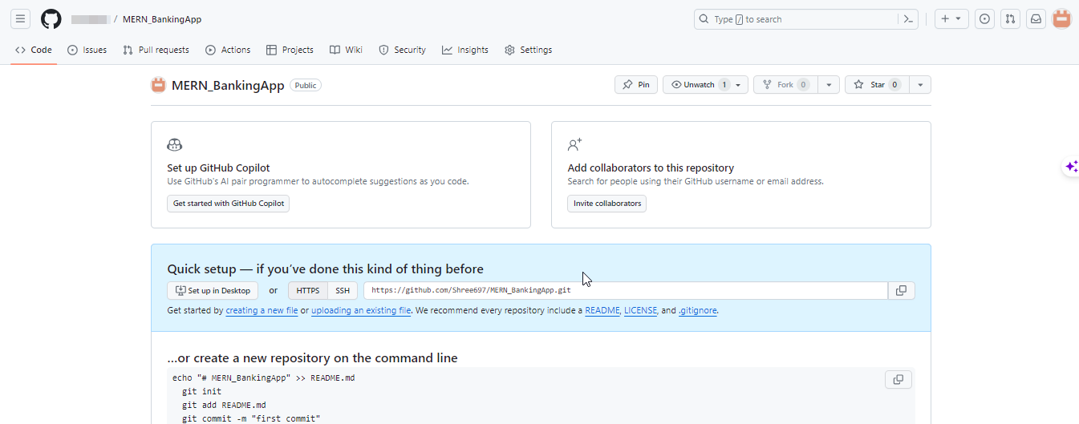
Create a Remote Repository
Create a remote GitHub repository named MERN_BankingApp

Slide 17
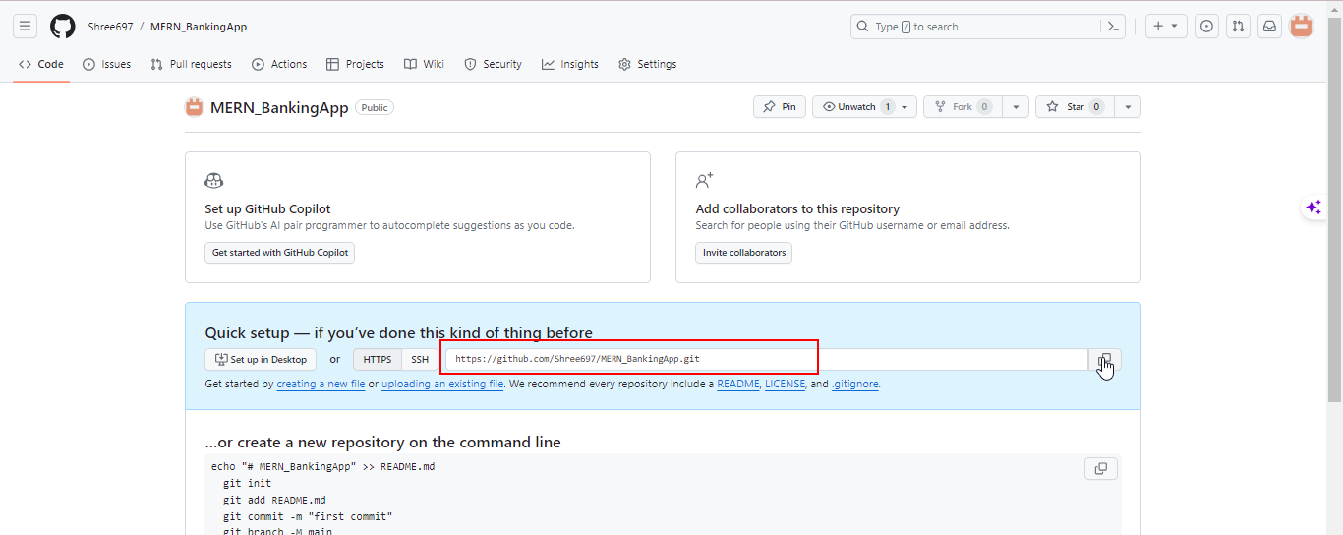
Create a Remote Repository
Copy the HTTPS remote URL and save it

Slide 18
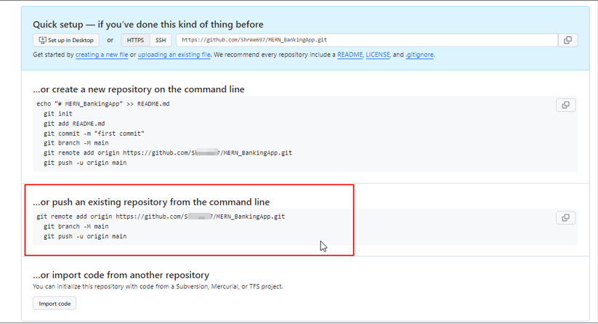
Push the Project into the Remote Repository
Push the local project directory into the remote repository using the following commands:

Slide 19
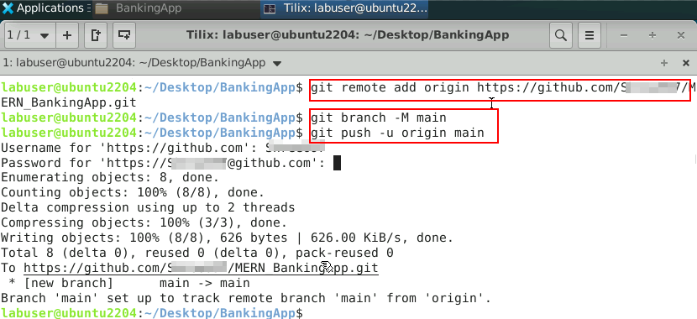
Push the Project into the Remote Repository
Open the terminal and execute the push commands

Slide 20
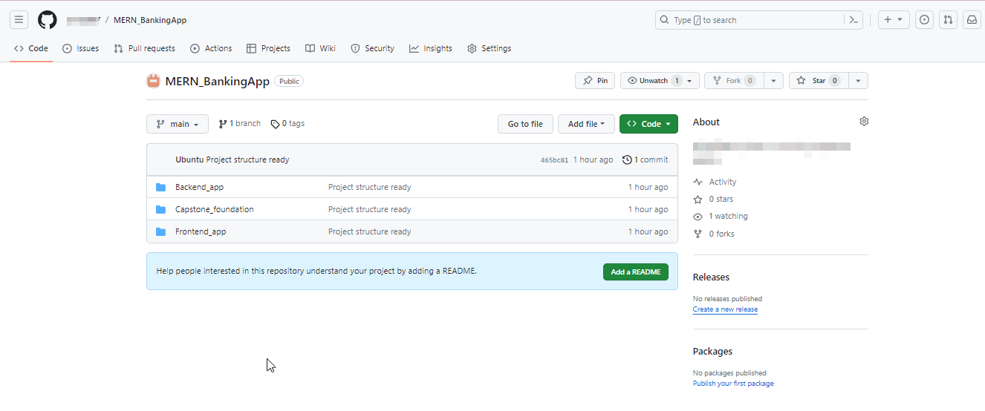
Push the Project into the Remote Repository
The project structure is pushed into the remote GitHub repository.

Slide 21
Conclusion
By the end of the session, it is expected that:
All the required user stories must be created for the admin and customer.
All these user stories will give a clear picture of the project development process.
A local Git repository must be created for all phases of the project development.
A remote Git repository must be created which will be linked with the local Git repository of the project.
This remote Git repository must be used for version control throughout the development process.

Slide 22
Thank you

